Slide 1
Nonlinear programming (NLP) using GAMS and Pyomo

Slide 2
Agenda
Review nonlinear programming
Example 1 (nonlinear regression)
Coding in GAMS
Coding in Python
Example 2 (geometric example)
Coding in GAMS
Coding in Python
Example 3 (resource allocation)
Coding in GAMS
Coding in Python

Slide 3


Review nonlinear programming
Nonlinear programming (NLP)
f, h, or g is nonlinear
x is all continuous variable
subject to

Slide 4

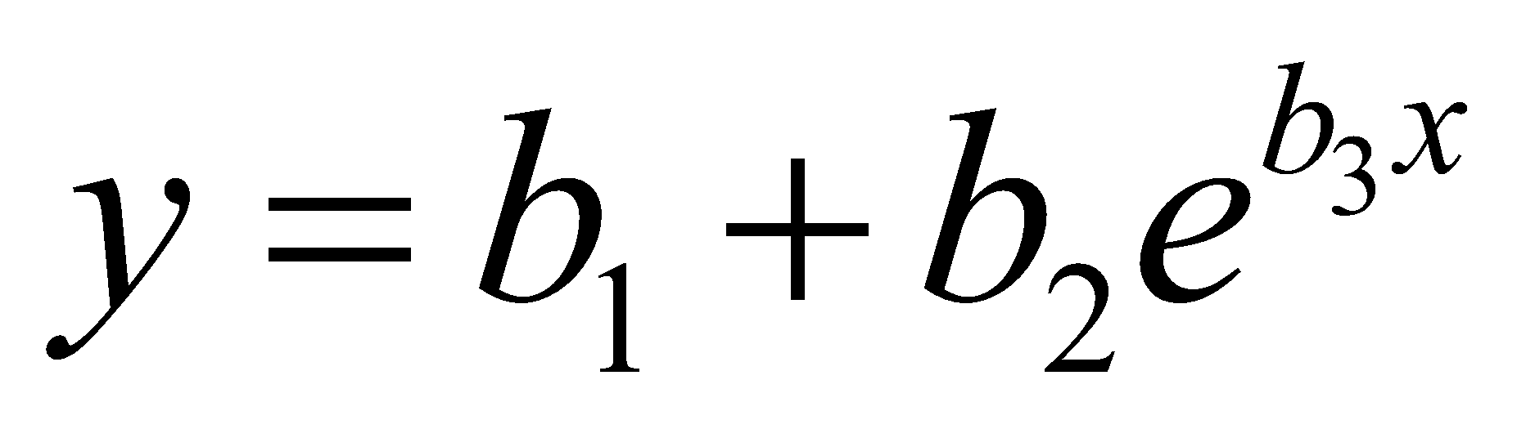
Example 1* - Nonlinear regression
Consider the nonlinear regression problem using the data x and y, where y is the dependent variable, and x is the independent variable.
6 observations/data points are available for this
regression model.
The required model structure is
Find the optimal values of regression coefficients
b₁, b₂, and b₃
y | x
127 | -5
151 | -3
379 | -1
421 | 5
460 | 3
426 | 1

Slide 5
Nonlinear regression – an overview
Regression, also known as curve-fitting, is a method to fit observed data to a specified model structure
Depending on the nature of the model, regression can be classified into 2 types
linear
nonlinear
Regression models are typically solved by minimizing the squares of deviation – this is called ‘ordinary least squares’ regression

Slide 6
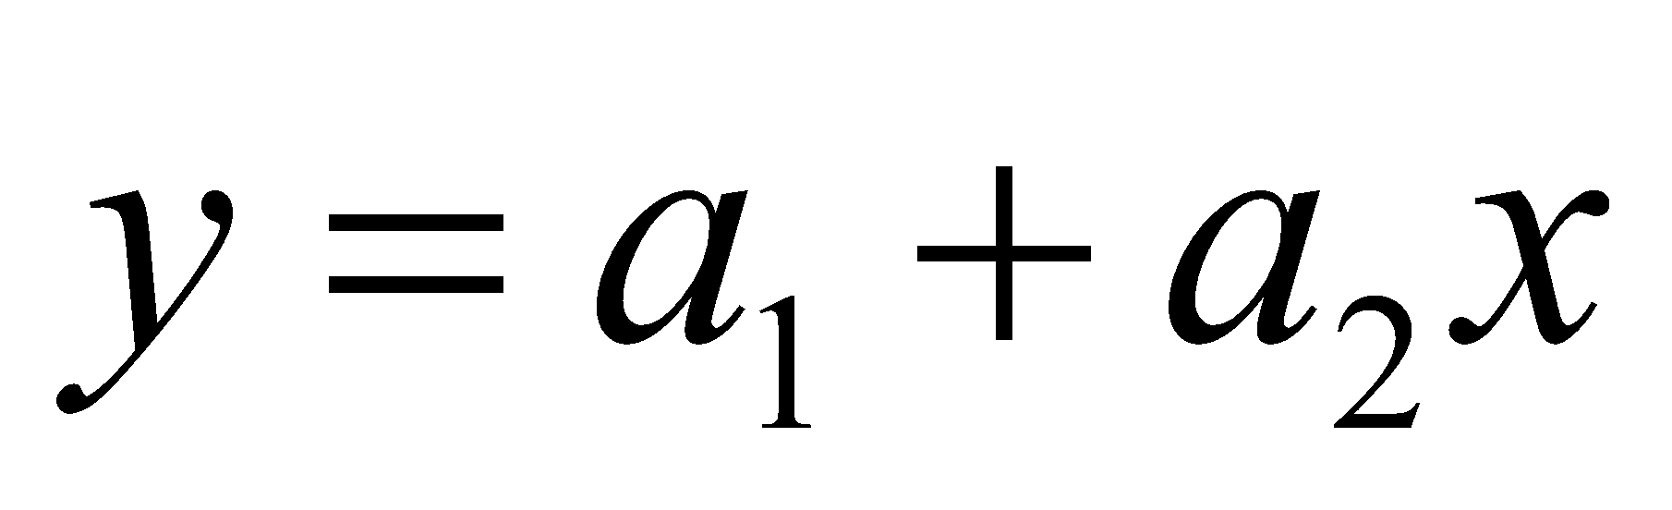
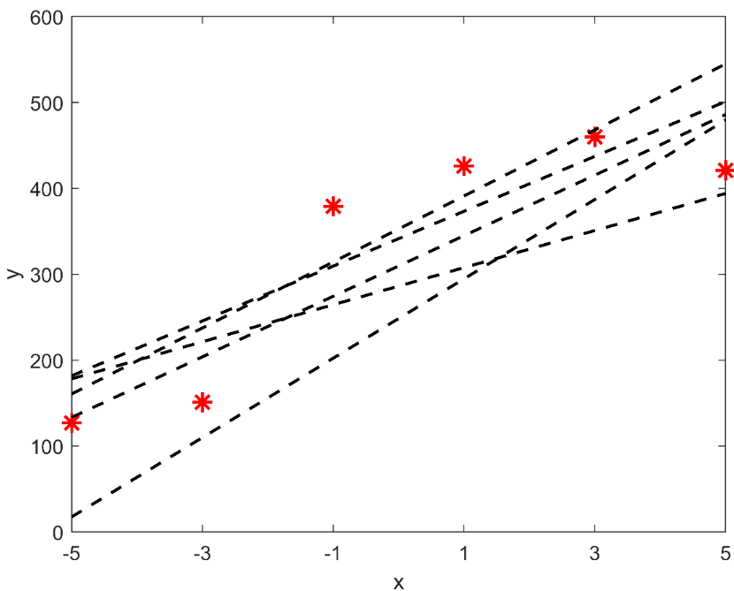
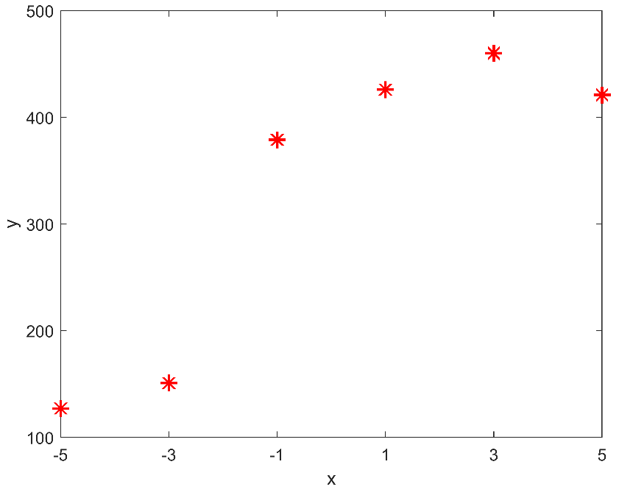
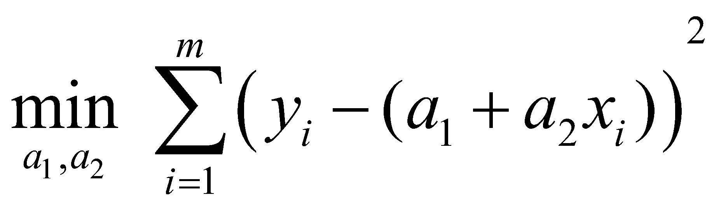
Example 1 – a linear regression approach
Consider a simple linear regression model:
Solving this using ‘least squares’ regression approach gives the optimization model -
Here, m denotes the number of data points
available

Slide 7
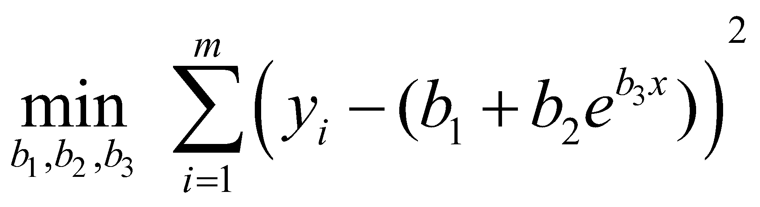
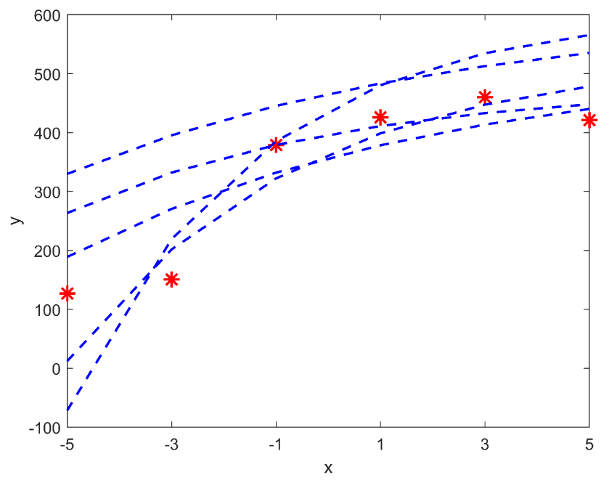
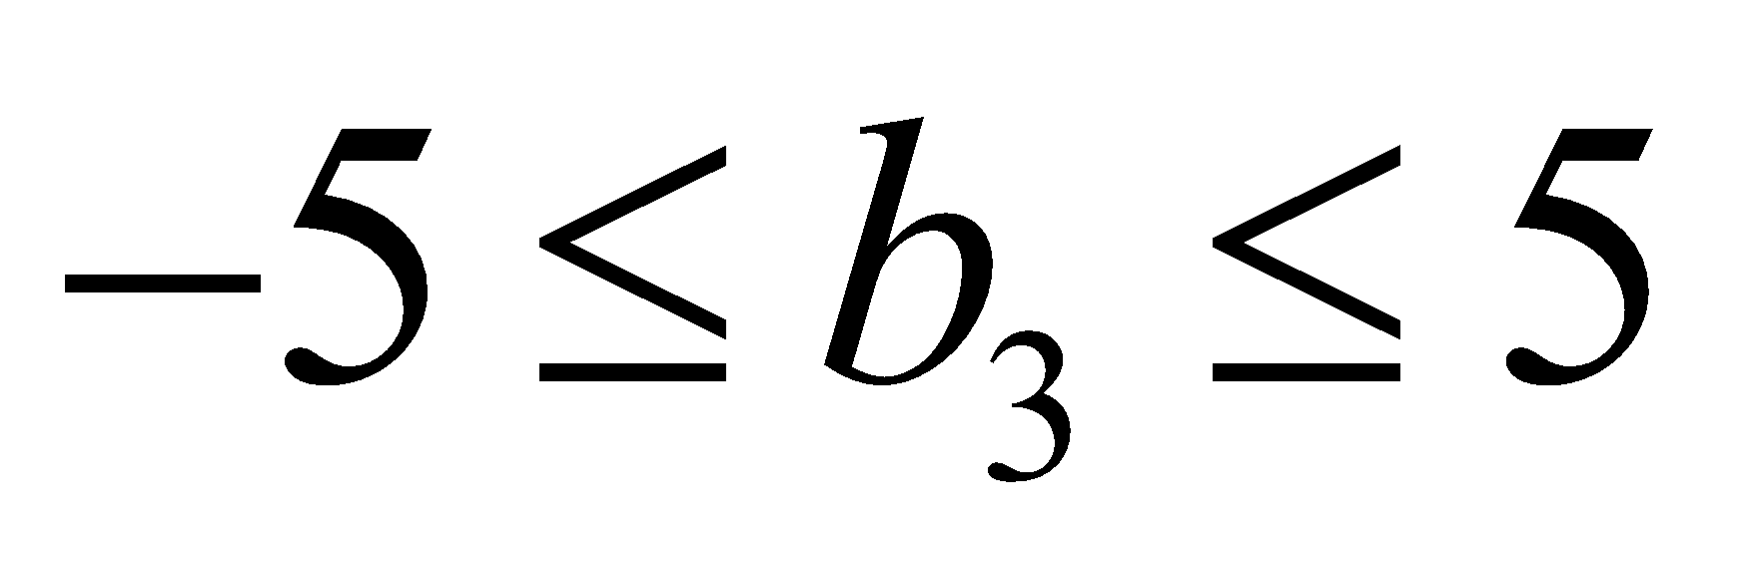
Example 1 – proposed nonlinear regression approach
Given nonlinear regression model structure:
Solving this using ‘least squares’ regression approach gives the optimization model
Given bounds on the coefficients:
Starting points for coefficients:
b₁ : 500
b₂ : -150
b₃ : -0.2

Slide 8
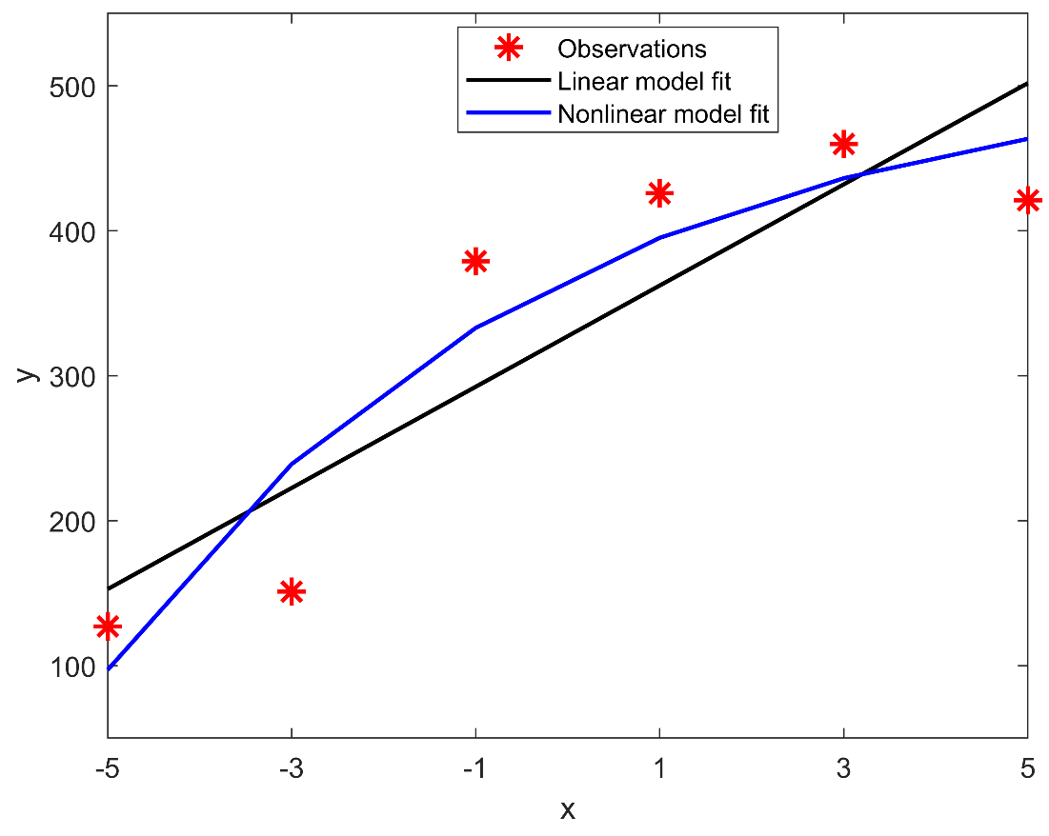
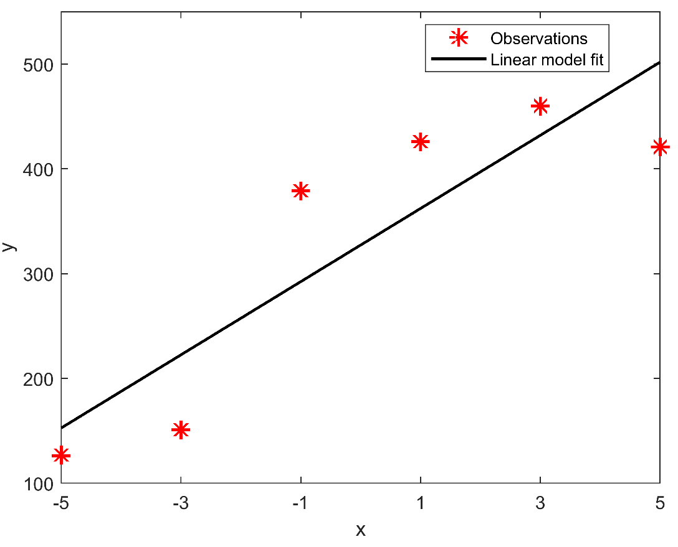
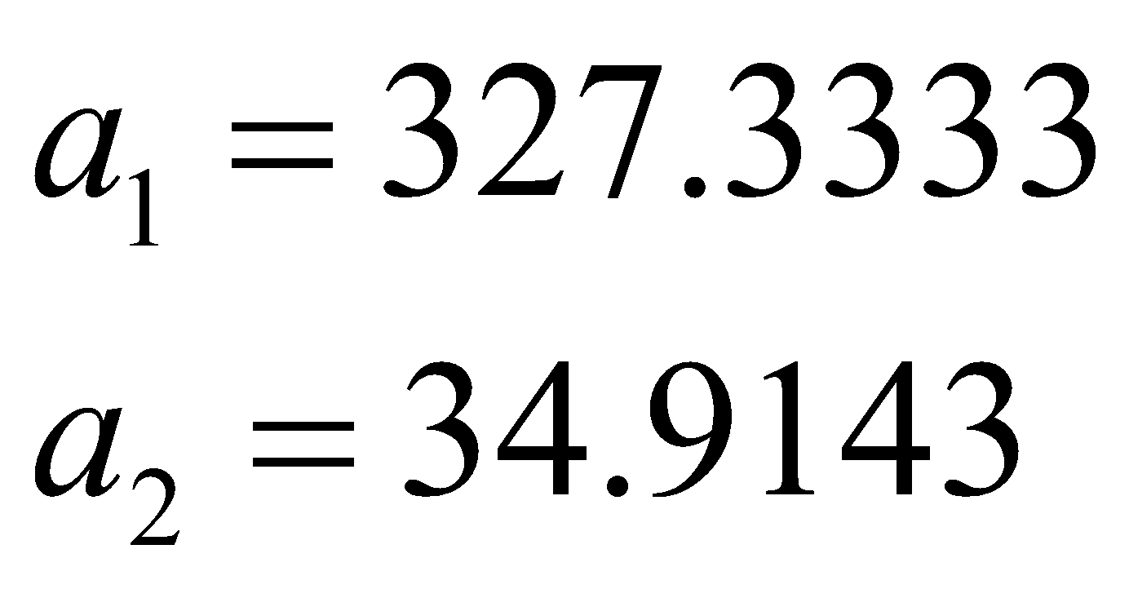
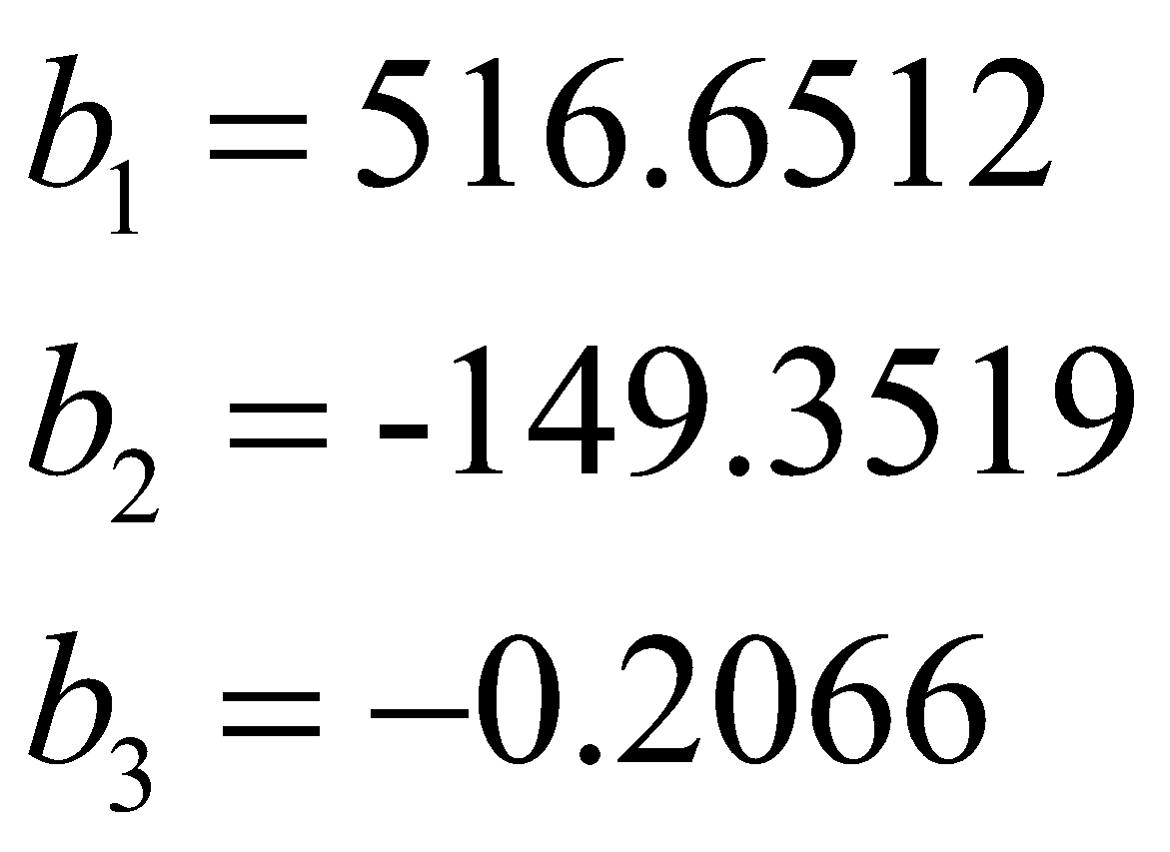
Example 1 – comparing regression models
Linear model:
(Deviation)² = 24674.8190
Nonlinear model:
(Deviation)² = 14085.1398

Slide 9
Example 1 – importance of initial guess (1)
Given nonlinear regression model structure:
Solving this using ‘least squares’ regression approach gives the optimization model
Given bounds on the coefficients:
Starting points for coefficients:
b₁ : 100
b₂ : -50
b₃ : -1.0

Slide 10
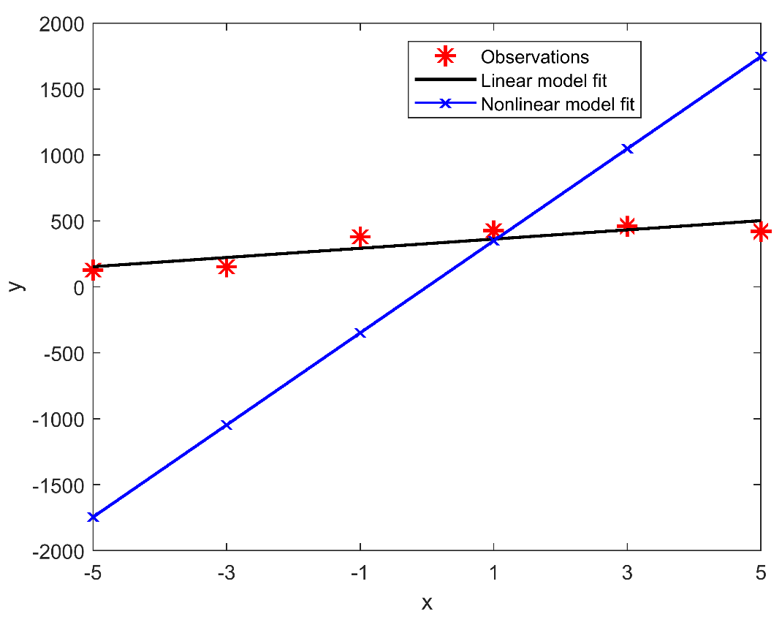
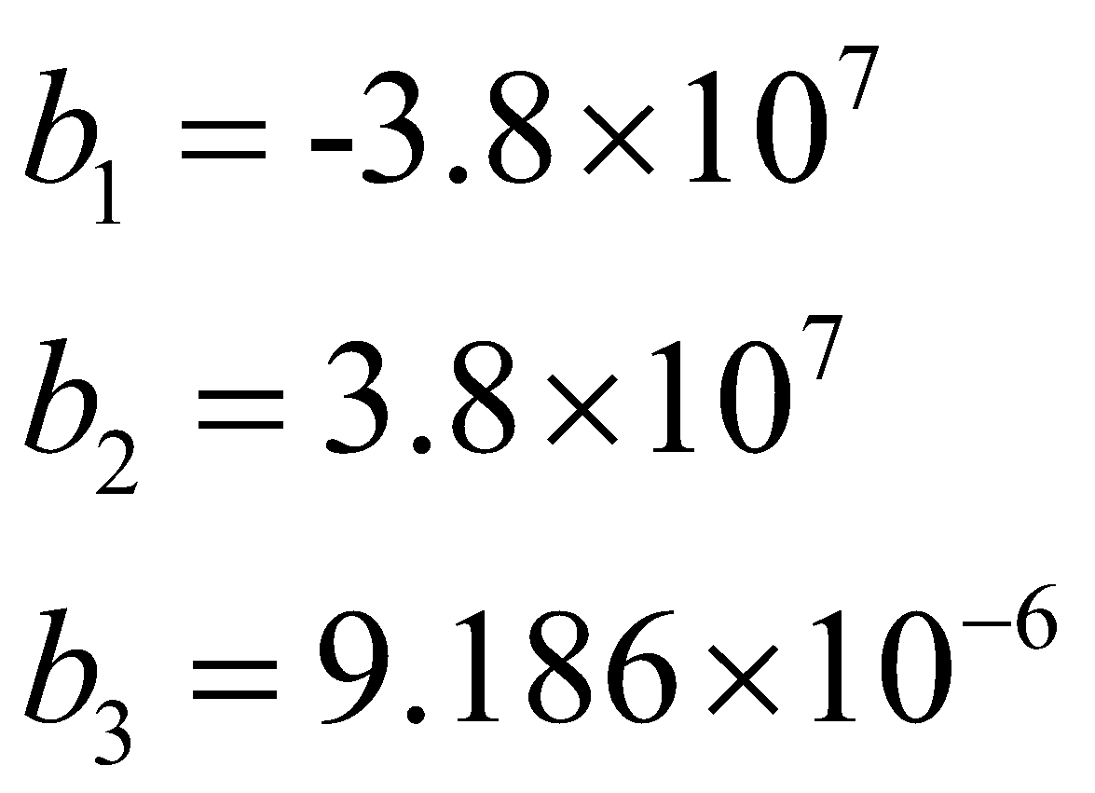
Example 1 – importance of initial guess (2)
Linear model:
(Deviation)² = 24674.8190
Nonlinear model:
(Deviation)² = 24674.9124

Slide 11
Example 1 – importance of initial guess (3)
Initial guess 1
Optimal solution
✔
GAMS
(CONOPT solver)
Initial guess 2
Optimal solution
✗
Initial guess 1
Optimal solution
✔
Pyomo
(IPOPT solver)
Initial guess 2
Optimal solution
✔

Slide 12
Example 2* - Geometric example
Given the unit circle (of radius 1), find a set of k = 5 identically-sized circles with an optimized (maximal) radius r so that all such circles are contained by the unit circle, in a non-overlapping arrangement
Need to find
Radius of the smaller circles
Centers of the smaller circles

Slide 13
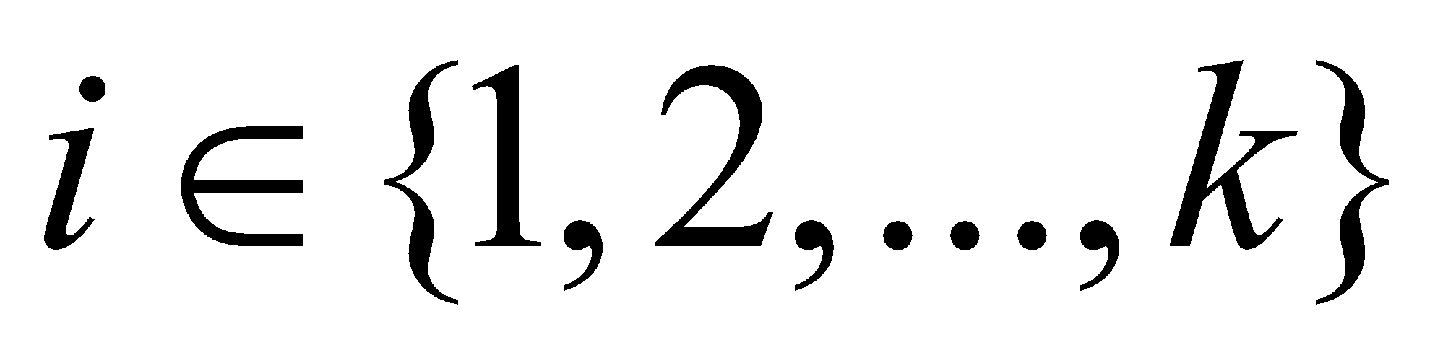
Organizing information – sets
Assume: The large unit circle is centered at the origin o = (0, 0)
Set of all identically-sized circles
Here, k is the number of identically-sized
circles that need to fit inside the unit circle
i = 2
i = 1
c_{i=2}
c_{i=1}
Radius = 1
i = 3
(0, 0)
i = 5
Radius= r
c_{i=3}
c_{i=5}
i = 4
c_{i=4}
k = 5

Slide 14

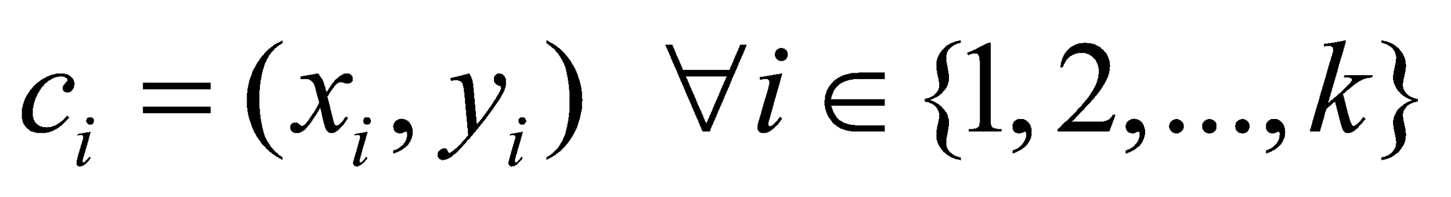
Organizing information – variables
Radius of the identically-sized circles
Centers of the identically-sized circles

Slide 15

Organizing information – objective function
Maximize: radius of the identically-sized circles = r
Objective function:

Slide 16
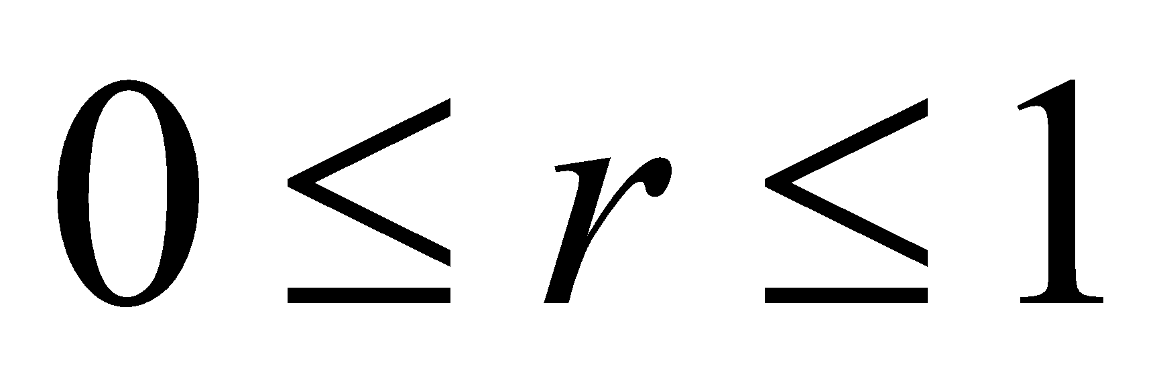
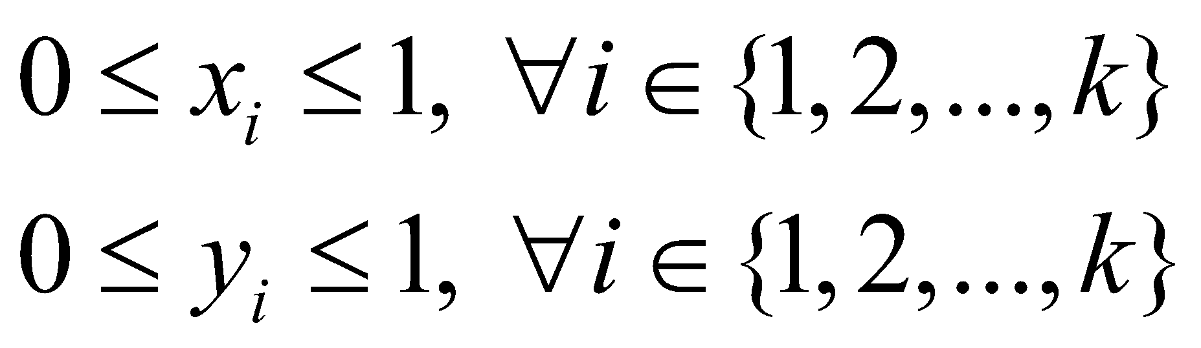
Organizing information – constraints (1)
Since the identically-sized circles must be placed within a unit circle,
The radius r must not exceed 1
(eq1)
The coordinates of the centers c_{i} must not exceed 1
(eq2)
(eq3)

Slide 17
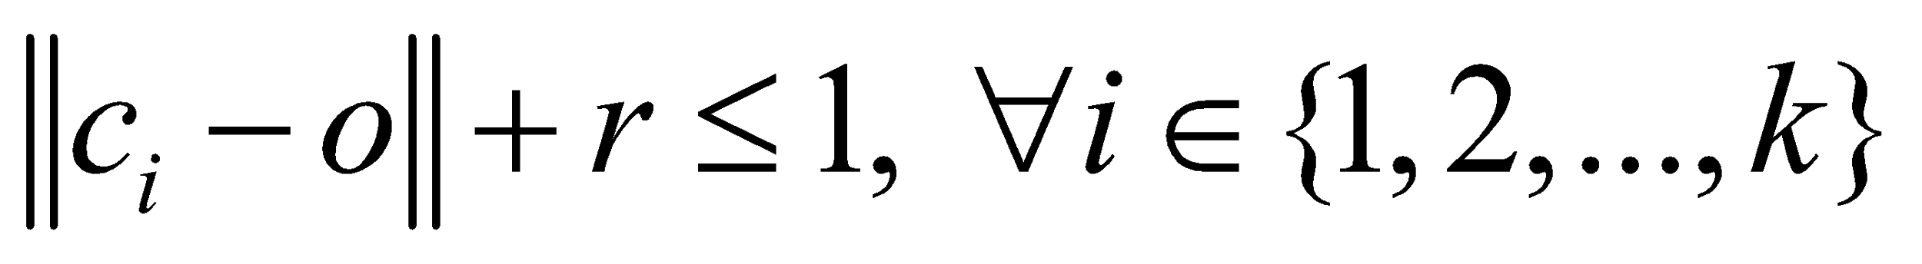
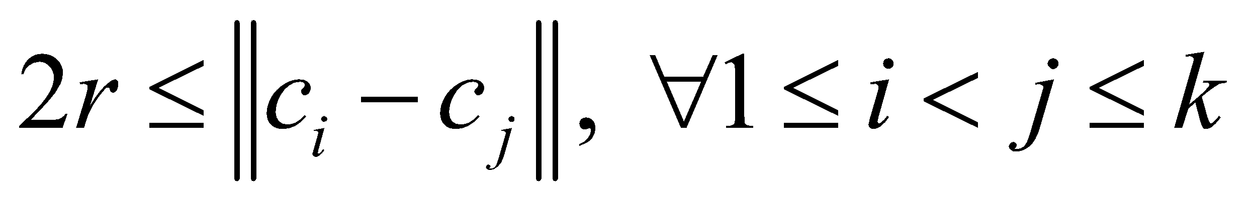
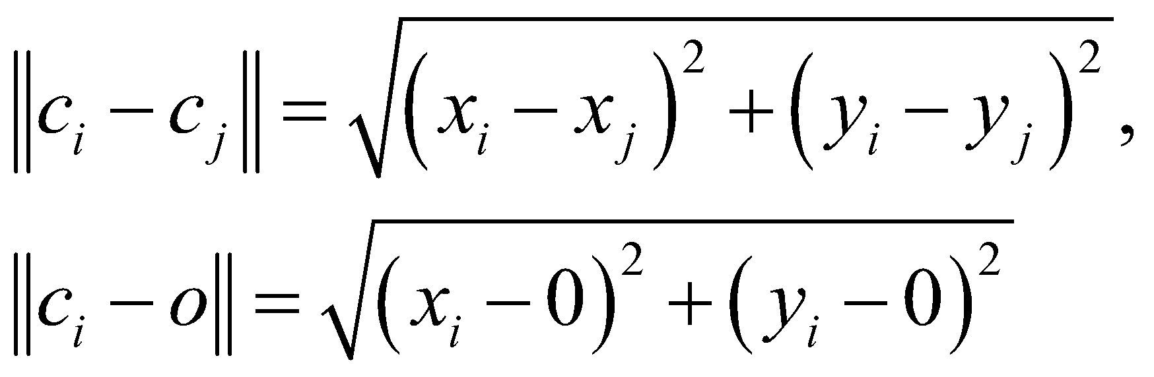
Organizing information – constraints (2)
The identically-sized circles must be contained within a unit circle,
(eq4)
The identically-sized circles must not overlap, the distance between circle centers must be at least the diameter of the circles, 2r
(eq5)
Here,

Slide 18
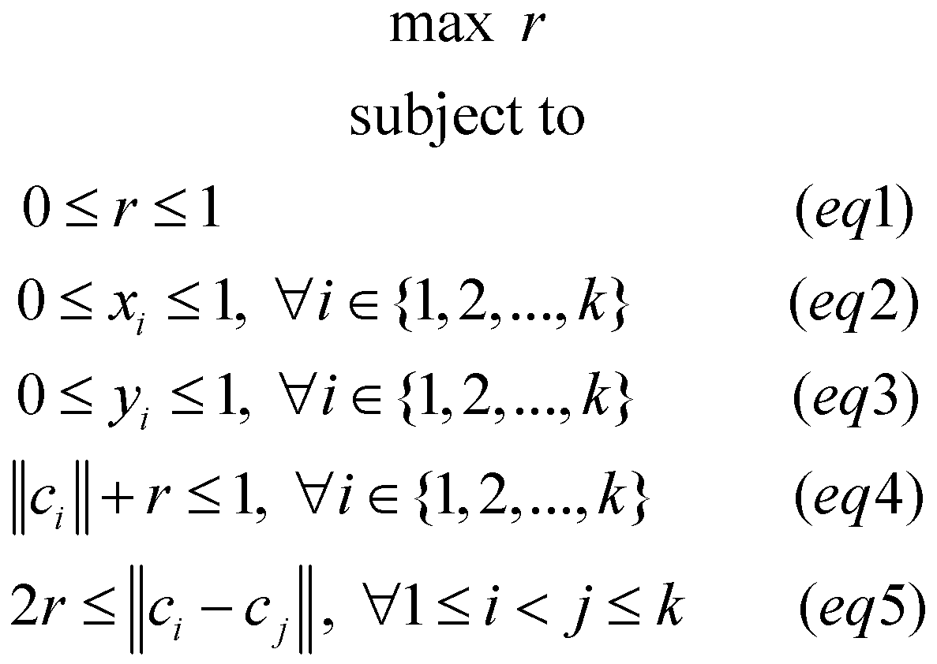
Assembling optimization model

Slide 19
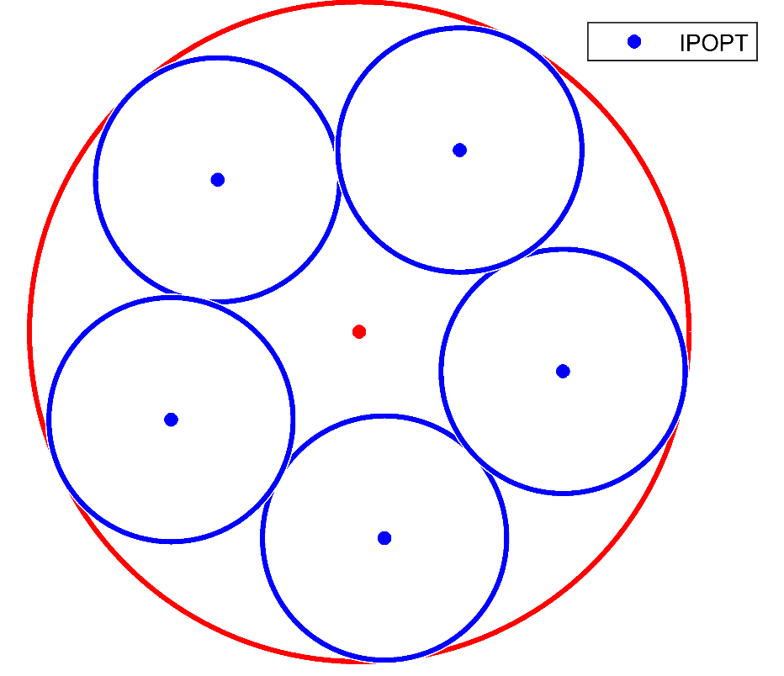
Example 2 – importance of solver (1)
NLP solver: IPOPT
Circle number i | Center coordinates c_{i}
1 | (-0.4296, 0.4605)
2 | (0.0769, -0.6251)
3 | (-0.5707, -0.2663)
4 | (0.6183,-0.1200)
5 | (0.3052, 0.5509)
Radius | 0.3702

Slide 20
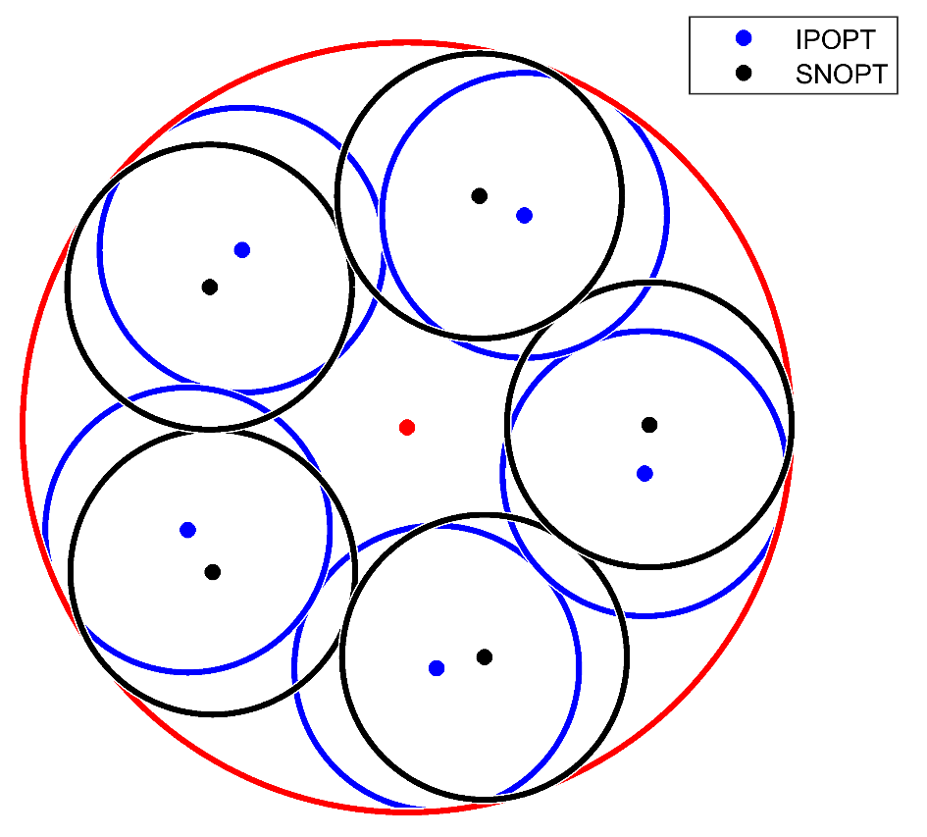
Example 2 – importance of solver (2)
NLP solver: SNOPT
Circle number i | Center coordinates c_{i}
1 | (-0.5054, -0.3757)
2 | (0.2012, -0.5968)
3 | (-0.5135, -0.3646)
4 | (0.6298, 0.0069)
5 | (0.1881, 0.6011)
Radius | 0.3702

Slide 21
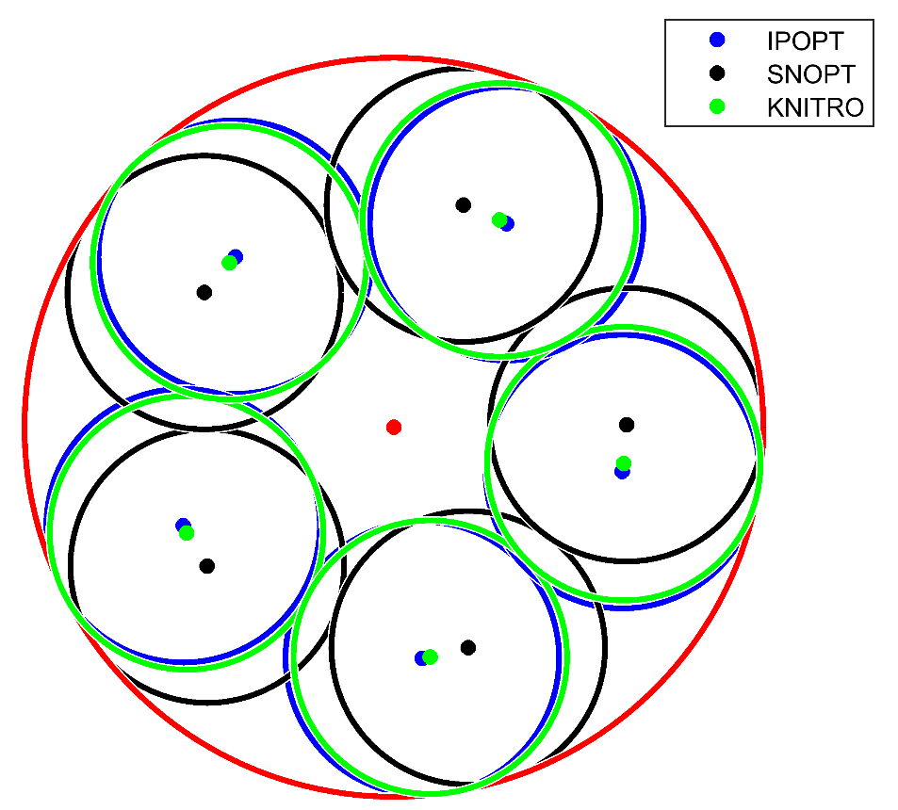
Example 2 – importance of solver (3)
NLP solver: KNITRO
Circle number i | Center coordinates c_{i}
1 | (-0.5612, -0.2859)
2 | (-0.4453, 0.4453)
3 | (0.0985, -0.6221)
4 | (0.6221, -0.0985)
5 | (0.2859, 0.5612)
Radius | 0.3702

Slide 22
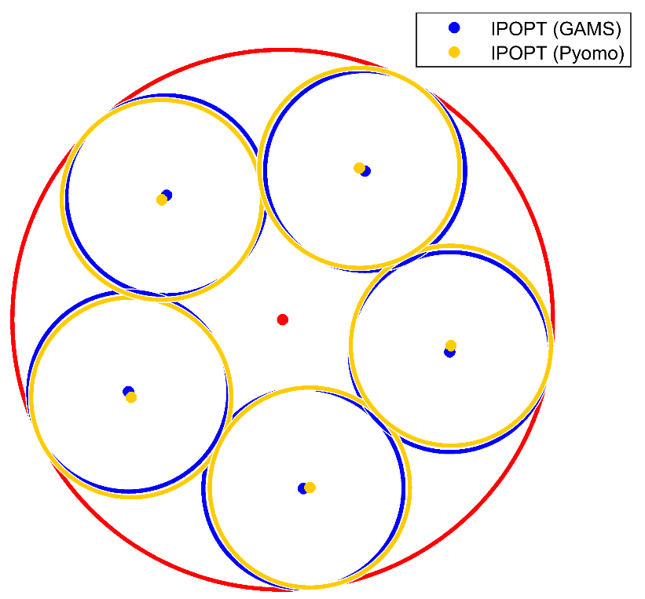
Example 2 – importance of solver (4)
Comparing IPOPT solvers’ solutions in GAMS
and Pyomo
Circle number i | Center coordinates c_{i} (GAMS) | Center coordinates c_{i} (Pyomo)
1 | (-0.4296, 0.4605) | (-0.5601, -0.2880)
2 | (0.0769, -0.6251) | (0.1008, -0.6217)
3 | (-0.5707, -0.2663) | (-0.4470, 0.4437)
4 | (0.6183,-0.1200) | (0.6224, -0.0962)
5 | (0.3052, 0.5509) | (0.2839, 0.5622)
Radius | 0.3702 | 0.3702

Slide 23
Example 3* - Resource allocation (1)
Determine the optimal allocation of weapons to targets, in order to inflict maximum damage. There are limits on the number of weapons that are available, as well as on the number of weapons allocated to each target. Each target has its own military value.
8
9
Weapon 1
Weapon 2
Weapon 3 All targets
Weapon 4
Weapon 5
2
6
1
7
3
4
18
5
10
17
19
12
14
11
15
13
16
20

Slide 24
Example 3 - Resource allocation (2)
Probability that weapon will not damage target
Weapons | Targets |  |  |  |  |  |  |  |  |  |  |  |  |  |  |  |  |  |  |  | Number of weapons available
 | 1 | 2 | 3 | 4 | 5 | 6 | 7 | 8 | 9 | 10 | 11 | 12 | 13 | 14 | 15 | 16 | 17 | 18 | 19 | 20
1 | 1.00 | 0.95 | 1.00 | 1.00 | 1.00 | 0.85 | 0.9 | 0.85 | 0.8 | 1.00 | 1.00 | 1.00 | 1.00 | 1.00 | 1.00 | 1.00 | 1.00 | 0.95 | 1.00 | 1.00 | 200
2 | 0.84 | 0.83 | 0.85 | 0.84 | 0.85 | 0.81 | 0.81 | 0.82 | 0.8 | 0.86 | 1.00 | 0.98 | 1.00 | 0.88 | 0.87 | 0.88 | 0.85 | 0.84 | 0.85 | 0.85 | 100
3 | 0.96 | 0.95 | 0.96 | 0.96 | 0.96 | 0.9 | 0.92 | 0.91 | 0.92 | 0.95 | 0.99 | 0.98 | 0.99 | 0.98 | 0.97 | 0.98 | 0.95 | 0.92 | 0.93 | 0.92 | 300
4 | 1.00 | 1.00 | 1.00 | 1.00 | 1.00 | 1.00 | 1.00 | 1.00 | 1.00 | 0.96 | 0.91 | 0.92 | 0.91 | 0.92 | 0.98 | 0.93 | 1.00 | 1.00 | 1.00 | 1.00 | 150
5 | 0.92 | 0.94 | 0.92 | 0.95 | 0.95 | 0.98 | 0.98 | 1.00 | 1.00 | 0.9 | 0.95 | 0.96 | 0.91 | 0.98 | 0.99 | 0.99 | 1.00 | 1.00 | 1.00 | 1.00 | 250
Minimum number of weapons to be assigned to target
 | 30 |  |  |  |  | 100 |  |  |  | 40 |  |  |  | 50 | 70 | 35 |  |  |  | 10
Military value of targets
 | 60 | 50 | 50 | 75 | 40 | 60 | 35 | 30 | 25 | 150 | 30 | 45 | 125 | 200 | 200 | 130 | 100 | 100 | 100 | 150

Slide 25
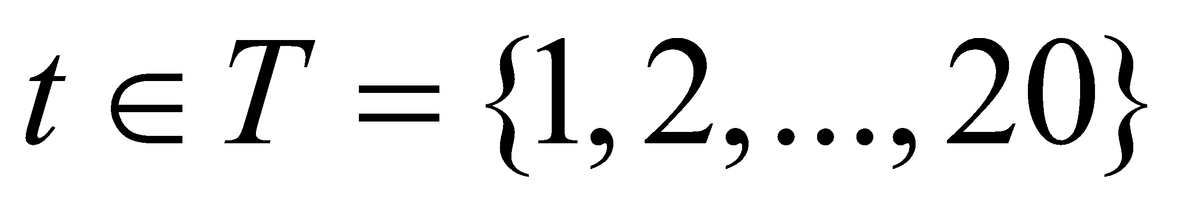
Organizing information – sets
Set of all weapons available
Set of all targets
(Sub)set of specified targets with minimum weapon allocation
Here,
ICBM: InterContinental Ballistic Missile
MediumRange Ballistic Missiles from area number 1
Long Range Bomber
Fighter Bomber
Medium Range Ballistic Missiles from area number 2

Slide 26
Organizing information – parameters (1)
Let φ_{w, t} be the probability that weapon w will not damage target t
Probability that weapon will not damage target
Weapons | Targets
 | 1 | 2 | 3 | 4 | 5 | 6 | 7 | 8 | 9 | 10 | 11 | 12 | 13 | 14 | 15 | 16 | 17 | 18 | 19 | 20
1 | 1.00 | 0.95 | 1.00 | 1.00 | 1.00 | 0.85 | 0.9 | 0.85 | 0.8 | 1.00 | 1.00 | 1.00 | 1.00 | 1.00 | 1.00 | 1.00 | 1.00 | 0.95 | 1.00 | 1.00
2 | 0.84 | 0.83 | 0.85 | 0.84 | 0.85 | 0.81 | 0.81 | 0.82 | 0.8 | 0.86 | 1.00 | 0.98 | 1.00 | 0.88 | 0.87 | 0.88 | 0.85 | 0.84 | 0.85 | 0.85
3 | 0.96 | 0.95 | 0.96 | 0.96 | 0.96 | 0.9 | 0.92 | 0.91 | 0.92 | 0.95 | 0.99 | 0.98 | 0.99 | 0.98 | 0.97 | 0.98 | 0.95 | 0.92 | 0.93 | 0.92
4 | 1.00 | 1.00 | 1.00 | 1.00 | 1.00 | 1.00 | 1.00 | 1.00 | 1.00 | 0.96 | 0.91 | 0.92 | 0.91 | 0.92 | 0.98 | 0.93 | 1.00 | 1.00 | 1.00 | 1.00
5 | 0.92 | 0.94 | 0.92 | 0.95 | 0.95 | 0.98 | 0.98 | 1.00 | 1.00 | 0.9 | 0.95 | 0.96 | 0.91 | 0.98 | 0.99 | 0.99 | 1.00 | 1.00 | 1.00 | 1.00

Slide 27
Organizing information – parameters (2)
Let α_{w} be the total number of weapons available per type w
Let β_{t} be the military value of each target t
t | β_{t} | t | β_{t}
1 | 60 | 11 | 30
2 | 50 | 12 | 45
3 | 50 | 13 | 125
4 | 75 | 14 | 200
5 | 40 | 15 | 200
6 | 60 | 16 | 130
7 | 35 | 17 | 100
8 | 30 | 18 | 100
9 | 25 | 19 | 100
10 | 150 | 20 | 150
w | α_{w}
1 | 200
2 | 100
3 | 300
4 | 150
5 | 250

Slide 28
Organizing information – parameters (3)
Let γ_{t} be the minimum number of weapons to be assigned to specified targets
t_spec | γ_{t_spec}
1 | 30
6 | 100
10 | 40
14 | 50
15 | 70
16 | 35
20 | 10

Slide 29
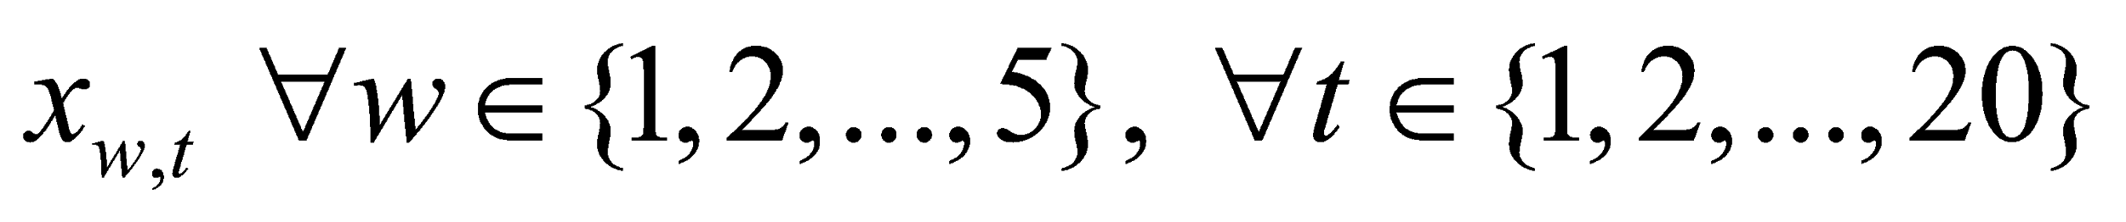
Organizing information – variables
Number of weapons w assigned to target t

Slide 30
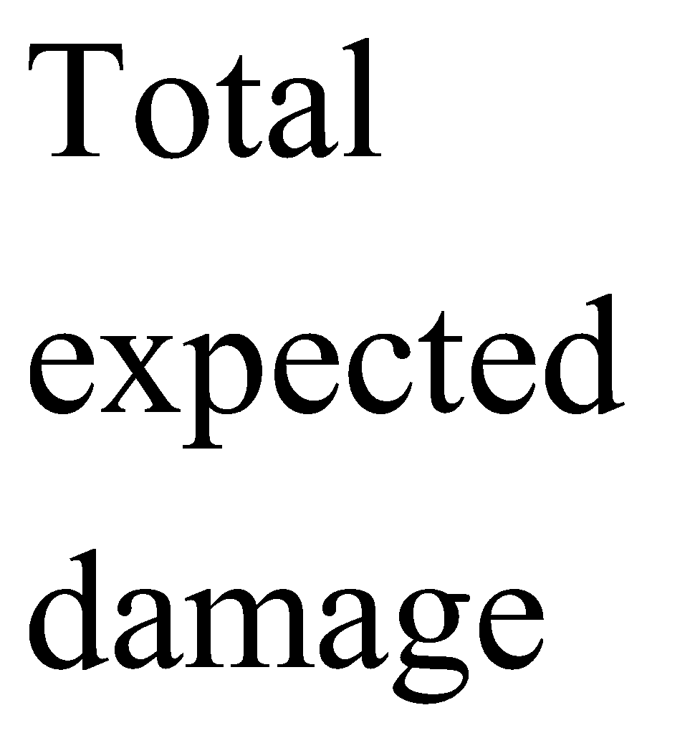
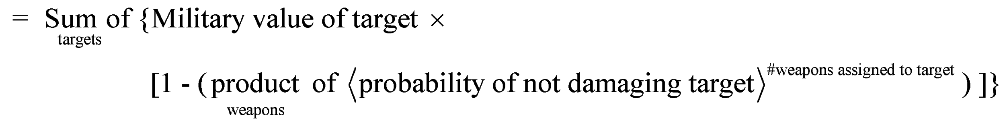
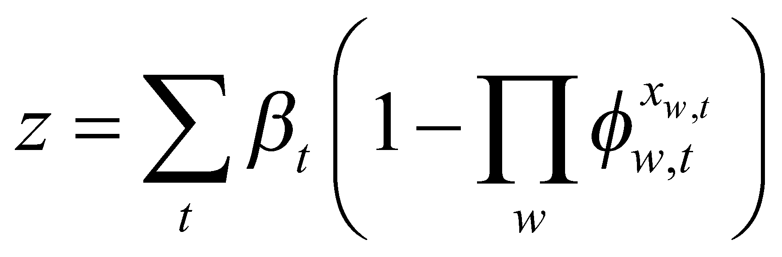
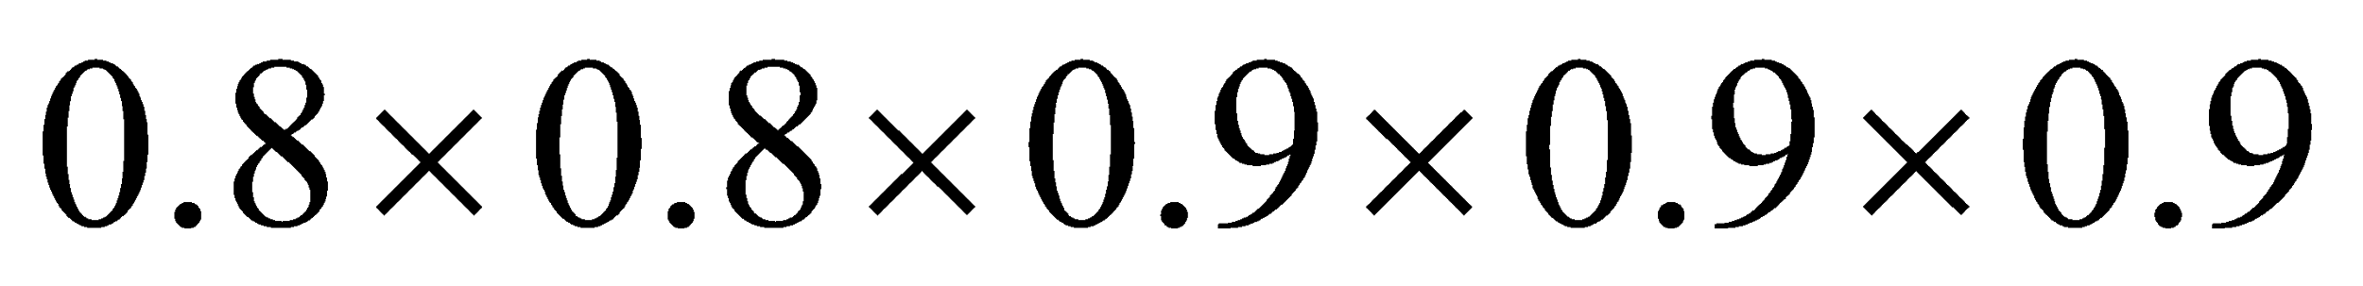
Organizing information – objective function
Maximize: total expected damage done to targets
Objective function:

Slide 31
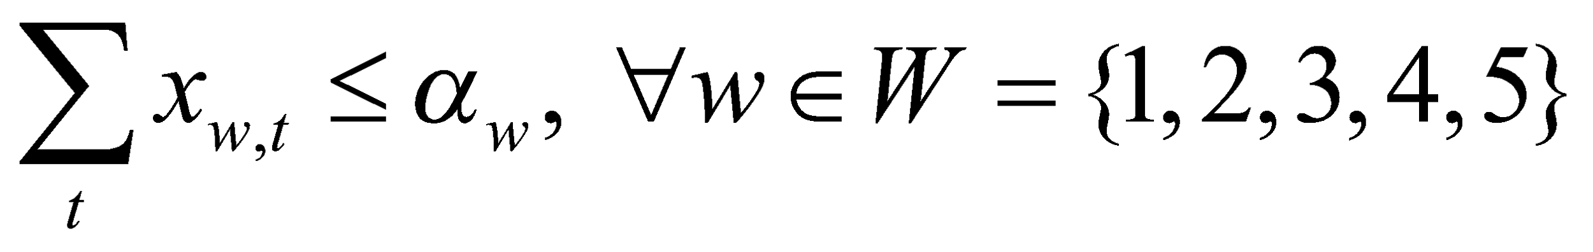
Organizing information – constraints
There is a limited number of weapons of each type w available
(eq1)
Specified targets have a minimum limits on weapons allocated
(eq2)
Minimum number of weapons w allocated to target t is 0
(eq3)

Slide 32
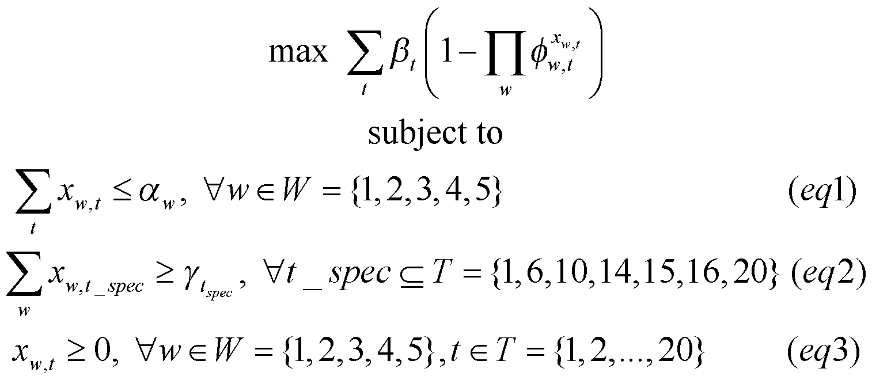
Assembling optimization model

Slide 33
Summary
In this video, we learnt
The general structure of a nonlinear optimization problem
Assigning lower and upper bounds to variables
Initializing variables
Conditional statement for constraints
Creating subsets
Introduction to coding simple NLP models in GAMS and Pyomo

